Slide 1
OHE has some significant shortcomings:
OHE representation produces very high dimensionality, this causes an increase in the model’s training and serving time and memory consumption.
OHE can easily cause a model to overfit the data.
OHE can’t handle categories that weren’t in the training data (like new URLs, new device types etc), this can be problematic in domains that change all the time.
https://blog.myyellowroad.com/using-categorical-data-in-machine-learning-with-python-from-dummy-variables-to-deep-category-66041f734512

Slide 2
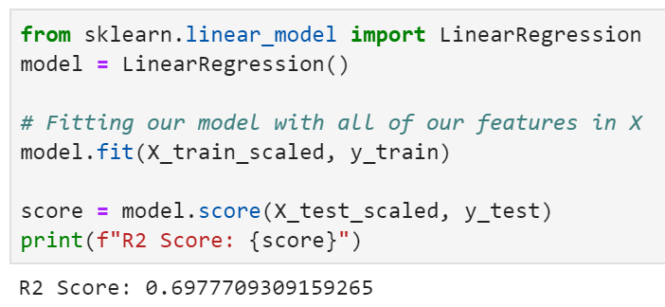
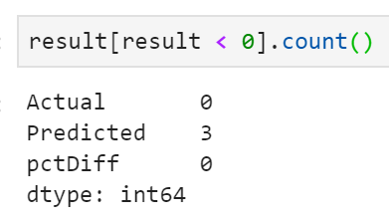
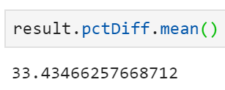
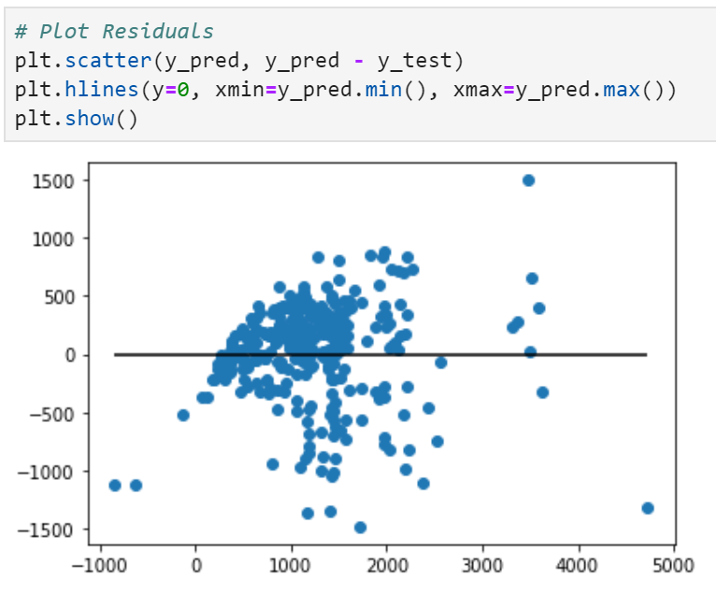
#1 Linear regression WITH OHE and WITH Scaling

Slide 3
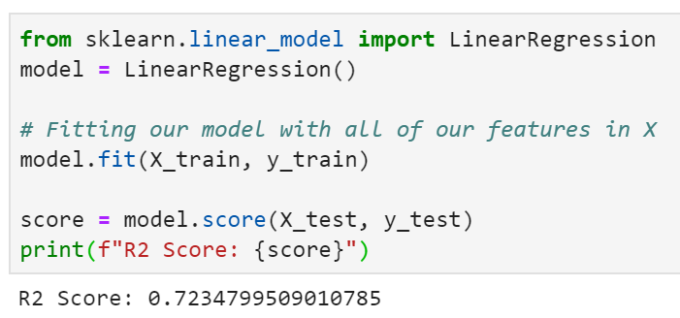
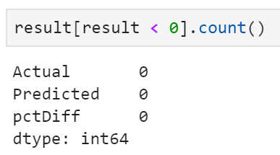
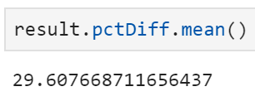
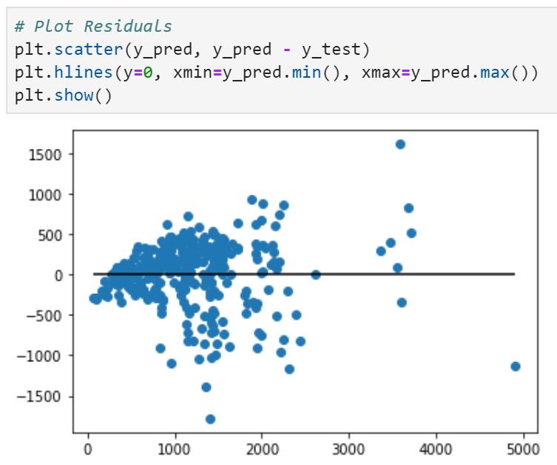
#2 Linear regression WITH OHE but WITHOUT Scaling

Slide 4
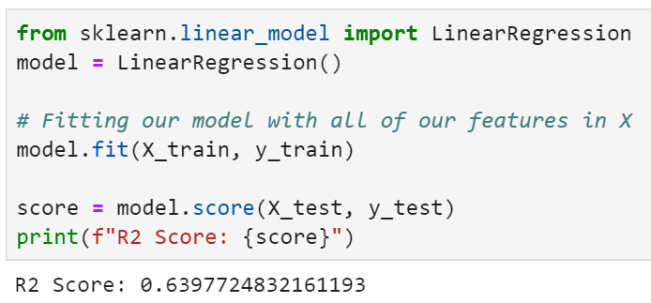
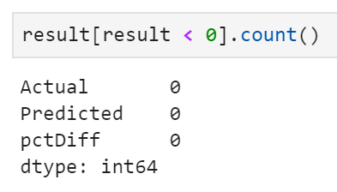
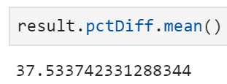
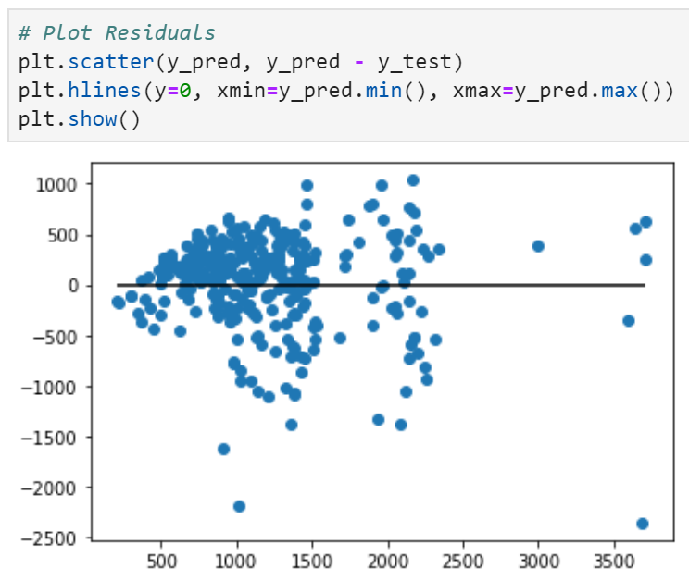
#3 Linear regression WITHOUT OHE (retain only continuous features) but WITH Scaling

Slide 5
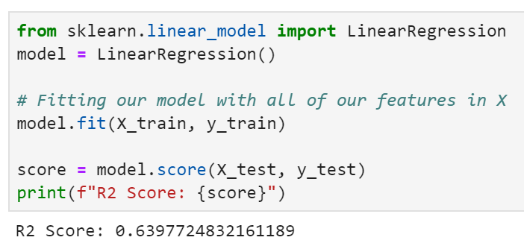
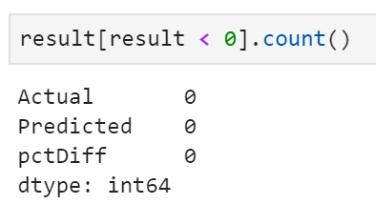
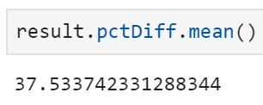
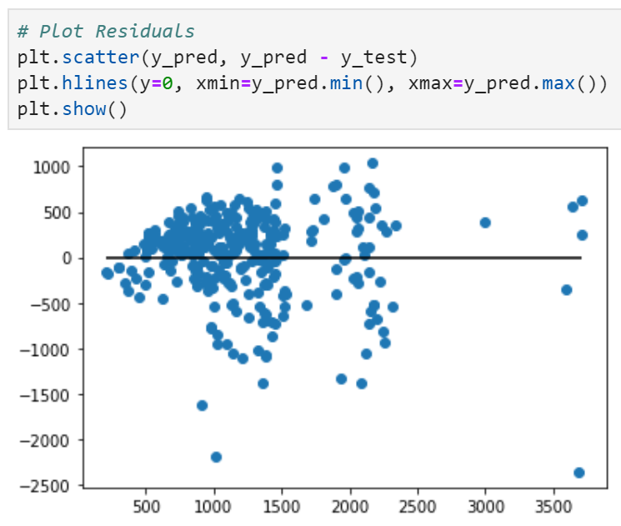
#4 Linear regression - WITHOUT OHE (retain only continuous features) and WITHOUT Scaling

Slide 6
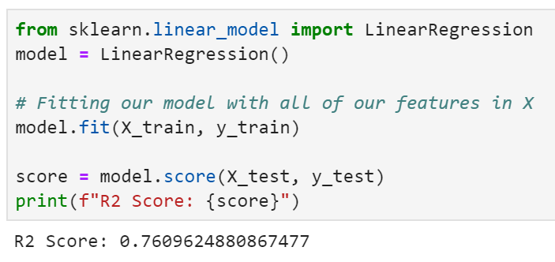
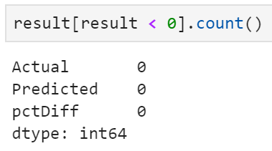
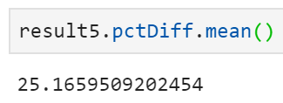
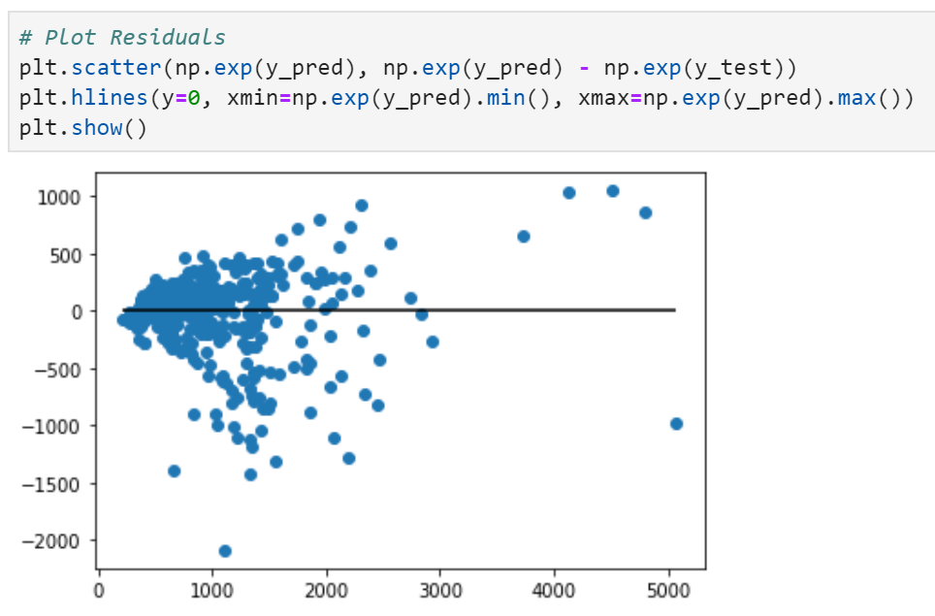
#5 Linear regression - After log transformation (Price); WITH OHE but WITHOUT Scaling

Slide 7

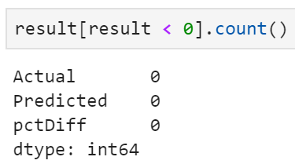
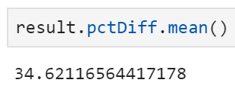
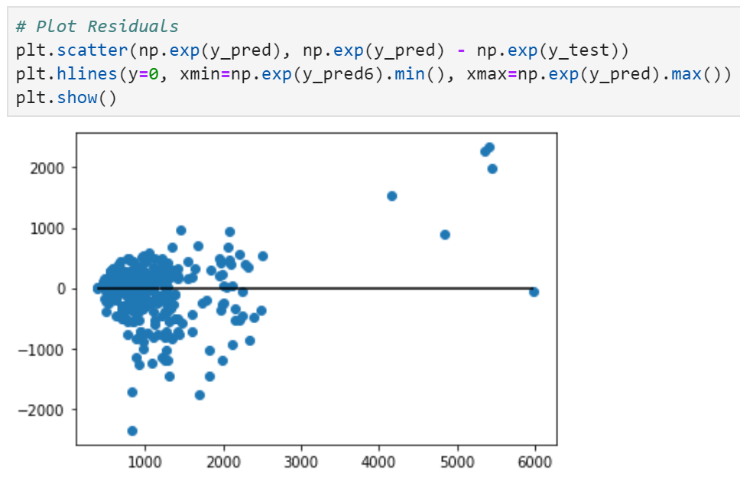
#6 Linear regression - After log transformation (Price); WITHOUT OHE and WITHOUT Scaling

Slide 8
Non-log-transformed price
Log-transformed price
 | OHE – Yes | OHE – No
Scaling of variable – Yes | LR Features = 42 R2 Score = 0.698 pctDiff = 33.4% RFR Features = 42 pctDiff = 20.0% | LR Features = 5 R2 Score = 0.640 pctDiff = 37.5% RFR Features = 5 pctDiff = 22.9%
Scaling of variables - No | LR Features = 42 R2 Score = 0.723 pctDiff = 29.6% RFR Features = 42 pctDiff = 20.0% | LR Features = 5 R2 Score = 0.640 pctDiff = 37.5% RFR Features = 5 pctDiff = 22.9%
 | OHE – Yes | OHE – No
Scaling of variable – Yes
Scaling of variables - No | LR Features = 42 R2 Score = 0.761 pctDiff = 25.2% RFR Features = 42 pctDiff = 18.7% | LR Features = 5 R2 Score = 0.608 pctDiff = 34.6% RFR Features = 5 pctDiff = 21.5%
RFR parameters used:
n_estimators = 100, random_state = 42

Slide 9
Non-log-transformed price
Log-transformed price
 | OHE – Yes | OHE – No
Scaling of variable – Yes | LR Features = 42 R2 Score = 0.698 pctDiff = 33.4% RFR Features = 42 pctDiff = 20.0% | LR Features = 5 R2 Score = 0.640 pctDiff = 37.5% RFR Features = 5 pctDiff = 22.9%
Scaling of variables - No | LR Features = 42 R2 Score = 0.723 pctDiff = 29.6% RFR Features = 42 pctDiff = 20.0% | LR Features = 5 R2 Score = 0.640 pctDiff = 37.5% RFR Features = 5 pctDiff = 22.9%
 | OHE – Yes | OHE – No
Scaling of variable – Yes
Scaling of variables - No | LR Features = 42 R2 Score = 0.761 pctDiff = 25.2% RFR Features = 42 pctDiff = 18.7% | LR Features = 5 R2 Score = 0.608 pctDiff = 34.6% RFR Features = 5 pctDiff = 21.5%
RFR parameters used:
n_estimators = 100, random_state = 42

Slide 10
Why and Where to Apply Feature Scaling?
Real world dataset contains features that highly vary in magnitudes, units, and range. Normalisation should be performed when the scale of a feature is irrelevant or misleading and not should Normalise when the scale is meaningful.
The algorithms which use Euclidean Distance measure are sensitive to Magnitudes. Here feature scaling helps to weigh all the features equally.
Formally, If a feature in the dataset is big in scale compared to others then in algorithms where Euclidean distance is measured this big scaled feature becomes dominating and needs to be normalized.
Examples of Algorithms where Feature Scaling matters 1. K-Means uses the Euclidean distance measure here feature scaling matters. 2. K-Nearest-Neighbours also require feature scaling. 3. Principal Component Analysis (PCA): Tries to get the feature with maximum variance, here too feature scaling is required. 4. Gradient Descent: Calculation speed increase as Theta calculation becomes faster after feature scaling.
Note: Naive Bayes, Linear Discriminant Analysis, and Tree-Based models are not affected by feature scaling. In Short, any Algorithm which is Not Distance based is Not affected by Feature Scaling.
https://www.geeksforgeeks.org/python-how-and-where-to-apply-feature-scaling/

